Slide 1
Tools Used in CLS
Ashwin Kumar Mandha
13th Sept 2010

Slide 2
Endevor
Path to Endevor EE;A
Common SCL’s used are
  ADD/UPDATE
  RETRIEVE
  GENERATE
  MOVE
  DELETE
  TRANSFER
  LIST ELEMENT
File Aid & Insync
Both are used to browse/Edit files with copybooks layouts
File Aid is also used for creating Multi-Volume Datasets.
And both are used Initializing/Verifying the VSAM’s.
Notes:
The preferred template works with a wider margin allowing easier readability and a cleaner, more professional look.

Slide 3


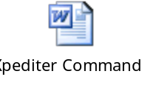
SDF
SDF is used for generating Maps.
Inertest & Xpediter
Setup for Xpediter.
Main Options in Intertest and Xpediter
Notes:
The preferred template works with a wider margin allowing easier readability and a cleaner, more professional look.

Slide 4
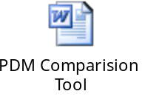

PDM
PDM is used to compare between dataset to dataset, Endeavor to Dataset, Dataset to Endeavor and Endeavor to Endeavor.
Abend Aid
Abend-AID is a programmer debugging and dump-formatting/reading tool from Compuware. It is used for both batch and CICS problem determination. It intercepts and analyzes application program failures to provide comprehensive fault diagnostics, reacting specifically to the type of error, the language of the failing program, and the types of files or databases in use. A concise, easy-to-read report, available in printed form or online, presents the most important information first and only the data necessary to solve the problem.
Notes:
The preferred template works with a wider margin allowing easier readability and a cleaner, more professional look.

Slide 5
Beta
Beta is used for history of the Batch Jobs (B;A).
We have past 6months History of all the Jobs.
Notes:
The preferred template works with a wider margin allowing easier readability and a cleaner, more professional look.

